Slide 1
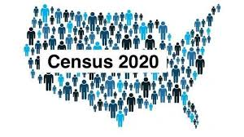
CENSUS 2020
IRC Student Leaders presents:

Slide 2
What is the Census?
1
Making sure every voice in your household and community is counted
2
Help provide resources for your community (schools, free lunch programs, housing, college funds).
3
The 2020 Census counts every person living in the 50 states, District of Columbia, and five U.S. territories.

Slide 3
What is the Census used for?
Population and demographics count of the people living in the U.S
To create jobs, provide housing, prepare for emergencies, roads and hospitals
To open new companies and businesses
For college students, it can benefit us through more financial aid and Cal Grants, scholarships, internships, etc.
It determines the number of seats each state has on the U.S. House of Representatives.
Notes:
highlight how the census benefits college students
put the by law into a different slide (confidentially)

Slide 4
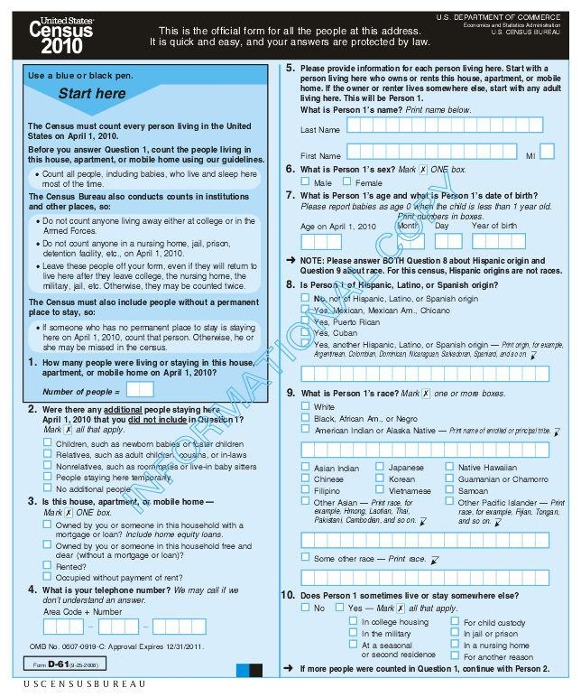
Only 9 Simple Questions
NAME, SEX, AGE AND DATE OF BIRTH, RACE, WHETHER A PERSON LIVES OR STAYS WITH YOU, AND THE RELATIONSHIP WITH YOU

Slide 5
Timeline
March 12th
-self response begins with an invitation to respond to the 2020 Census
October 31st
Last day for self response
August 11-October 31st
In-person interviews for non responders

Slide 6
April 8th-16th
A reminder letter and paper questionnaire will be sent out to households who have not responded
August 11th- October 31st
Non-response follow-up begins. Census-takers begin to visit homes through August
April 13th- August 14th
Census staff will assist people with responding online at places such as grocery stores and community centers.

Slide 7
Ways to do the census
Ways to do the census
By Mail- The paper Census form will be available in English and Spanish languages and can be mailed back to the U.S. Census Bureau.
By Phone- The Census can be completed by phone in 13 languages including Telecommunication Device for the Deaf.
Online- For the first time, the Census form will be available to complete online in 13 languages www.2020census.gov

Slide 8
Reasons why people don’t fill out the Census
IMMIGRATION STATUS
CITIZENSHIP STATUS
NUMBER OF HOUSEHOLD MEMBERS LIVING WITH THEM
THINK THAT THEIR PERSONAL DATA CAN BE REVEALED TO THE GOVERNMENT

Slide 9
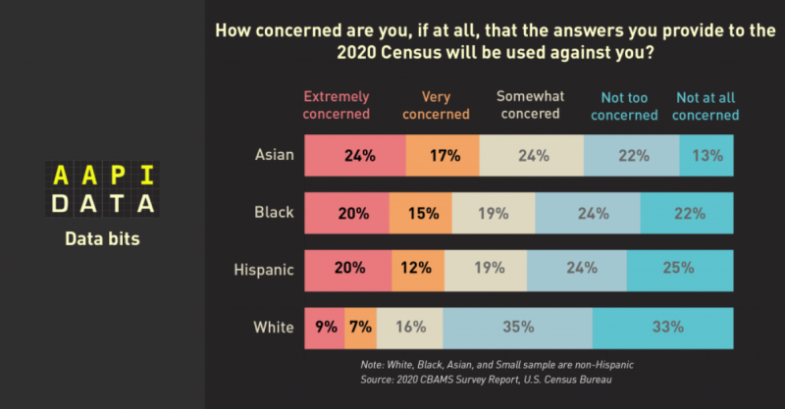
Notes:
asians are more fearful to fill out the Census
share the dominant narrative of AAPIs that will likely not fill out the census, prove that asians are extremely concern of how their data/answers will be used against them

Slide 10
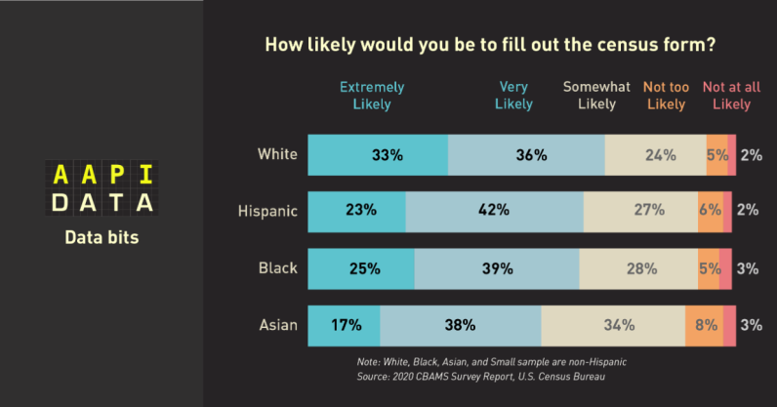
Notes:
this data shows that asians are least likely to fill out the census

Slide 11
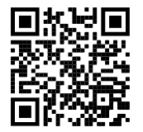
Census 2020 Pledge Form
Link: https://tinyurl.com/IRCCensus2020Pledge
Notes:
insert google pledge form

Slide 12
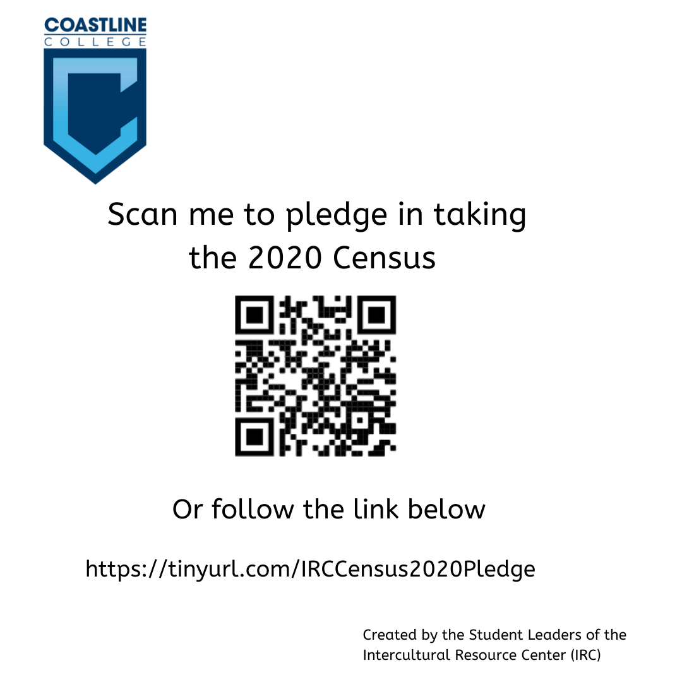
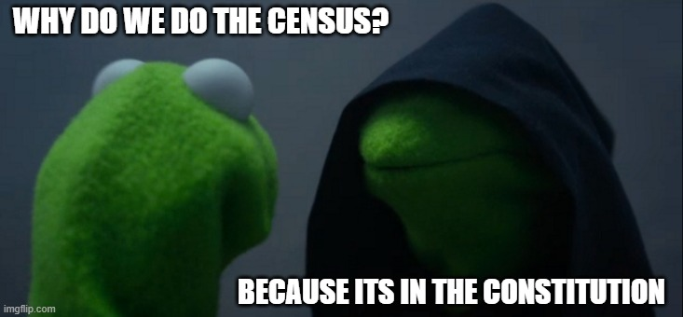
Census Memes & Tiktok

Slide 13
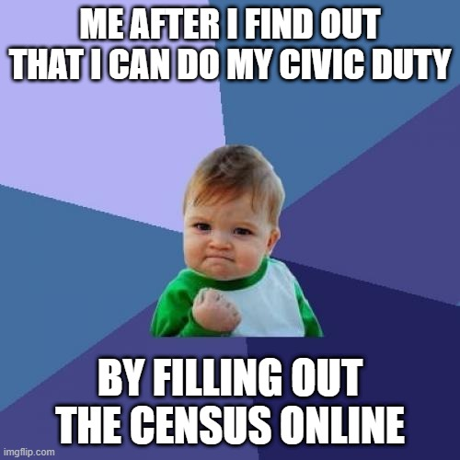
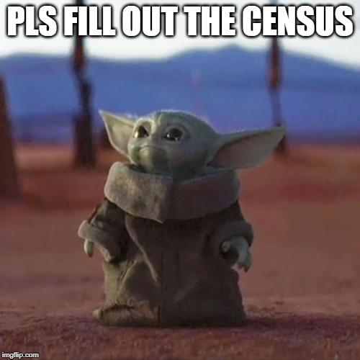
Census Memes & Tiktoks
Notes:
in addition out student leaders created materials to help talk about the census with other students in a fun and engaging way through memes and tik toks.

Slide 14
Census Meme & Tiktok
Census Tik Tok Video

Slide 15
Action Steps:
Post the pledge form and the memes about the Census on your Canvas Page
Encourage your students to participate in the Census Meme Challenge
Offer extra credit for students to fill out the Census
Notes:
the counter narratives to asians not filling out the census is for us to engage and encourage our communities to do the census
after this presentation i want you to do the following…
in addition out student leaders created materials to help talk about the census with other students in a fun and engaging way through memes and tik toks.

